Slide 1
Assessing the relationship between Healthcare spending and economic performance in the United States using analytics
Team Spotfire: Johnathan Jackson, Teena George,
YuXuanWang, Yaxin Chen
BYGB7975
BUS ANALYTICS FOR MANAGERS
04/23/2018

Slide 2
Abstract
The United States lags behind several other developed countries in measures of both mortality and life expectancy, but boats one of the highest amounts of healthcare spending.
A method of comparison for health care systems is through the use of the systems’ Macroeconomic Indicators.
With the data available publicly in the US, it is possible to determine whether or not health care spending has a measurable impact on the US economy through the use of analytics.

Slide 3
Introduction
Health care costs have been rising in the United States, to the point where the rate of growth has outpaced growth in income.¹
Health spending is projected to continue growing at an average rate of 5.8 percent from 2012-2022
This is 1.0 percentage point faster than expected average annual growth in the Gross Domestic Product (GDP).²
This bloated spending has not necessarily led to better health outcomes, as the US lags behind several countries in life expectancy.³
Notes:
This bloated spending has not necessarily led to better health outcomes, as the US lags behind several countries in life expectancy.³

Slide 4
Importance
Citizens and policy makers are constantly questioning why we continue to spend so much without changing the system.
One way we can seek to justify health costs is for their economic value.
We do know that employee health does have an effect on productivity and employers’ bottom lines. ⁴
Exactly how much does health care spending impact US productivity and growth?

Slide 5
Problem Statement & Explain
Problem statement: Exploring the correlation between Healthcare Spending in the United State and Macroeconomic Indicators.
To figure out an increase on health costs has a positive effect or negative effect on the economy.

Slide 6
Hypothesis
There is a positive correlation between healthcare spending and labor productivity, personal income, per capita GDP, percent change in MFP.
There is a negative correlation between healthcare spending and Average hours per day spent purchasing goods & services and other spending.
An increase on the health costs could have no effects on some macroeconomic Indicators.
Different states have varying effect of healthcare spending.

Slide 7
Independent Variables & control variables
Independent Variable | Scale | Type
PCPersonalHealthcare | ratio | float
PCHospital | ratio | float
PCPhysician | ratio | float
PCOtherProfessionalService | ratio | float
PCHomeHealth | ratio | float
PCNursing | ratio | float
PCDrugs | ratio | float
Control Variable | Scale | Type
Population | norminal | Integer
State/region | norminal | String
Year | norminal | numeric
Notes:
Year
Categorical/character
We will drill up from state to country
State/Region

Slide 8
Dependent Variables
Variable Name | Scale | Type
PCPersonalIncome | ratio | float
PCEminushealthE | ratio | float
PCGDP | ratio | float
%change in MFP | ratio | float
Average Weekly hours worked | ratio | float
Total Hours Worked | ratio | float
Labor Productivity (index, 2009 is base year) | ratio | float
Average hours per day spent purchasing goods & services | ratio | float
Rationale:
In order to study the relationship between health care costs and macroeconomic indicators , we have to find the components of health costs and macroeconomic indicators.
Healthcare costs include: Personal health costs, personal hospital costs, personal physician costs, other professional service, personal home health costs, personal nursing costs and personal drugs costs.
Macroeconomic indicators include: personal income, other spending ,per capital GDP, percent change in GDP, Average Weekly hours worked, Total Hours Worked, Labor Productivity, Average hours per day spent purchasing goods & services.

Slide 9
Data
Size : 18 columns* 709 rows =12, 762
Number of years: 12 years.
Period: 2003~2014
Web link to data :
https://www.cms.gov/Research-Statistics-Data-and-Systems/Statistics-Trends-and-Reports/NationalHealthExpendData/NationalHealthAccountsStateHealthAcc
https://www.bea.gov/iTable/iTable.cfm?reqid=70&step=1&isuri=1&acrdn=2#reqid=70&step=1&isuri=1
https://www.bls.gov/lpc/data.htm
https://www.bls.gov/webapps/legacy/tusa_1tab1.htm

Slide 10
Tool selection
Excel: Through the use of VBA scripts, we were able to merge our multiple datasets using year and state as indices
Tableau : Tableau was used for our 12 visualizations
R : Statistical model
SPSS: Machine learning model

Slide 11
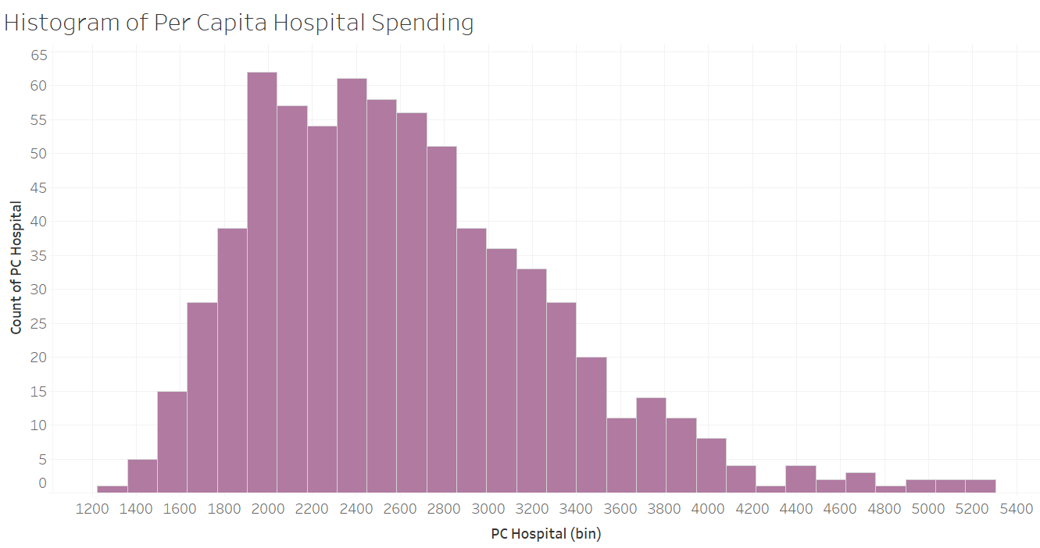
Chart 1
Figure 1
This histogram shows the distribution of per capita hospital spending
The mean per capita healthcare spending is $2,600, but there is a large amount of spending in the outlier region
Hospital Spending has may seem to be increasing slowly when looking at the mean, but at the state level there are still very expensive hospital visits

Slide 12
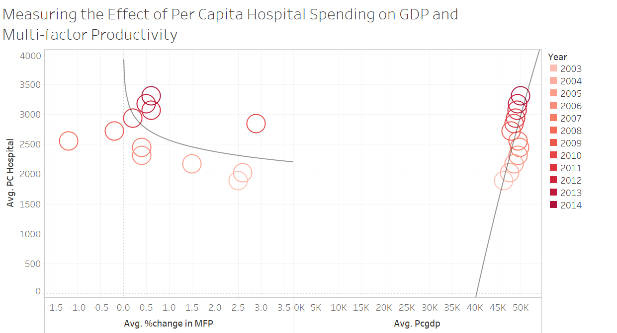
Chart 2
Figure 2
This circle chart shows the relationship between hospital spending and changes in multifactor productivity and per capita GDP
We see higher hospital costs related to drops in MFP and increases in GDP
Unfortunately, this suggests that hospital spending has not been increasing this measure of productivity in the US

Slide 13
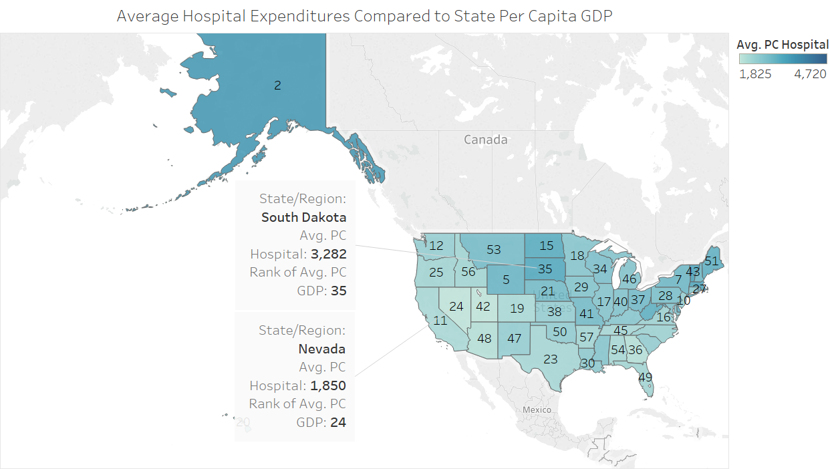
Chart 3
Figure 3
This map shows per capita hospital spending across the country and ranks the state’s GDP
Unsurprisingly, we see that progressive states such as California with high GDP have lower per person hospital spending
This suggests that some of the legislative and innovative measures taken in states that support research work to lower costs to the patient

Slide 14
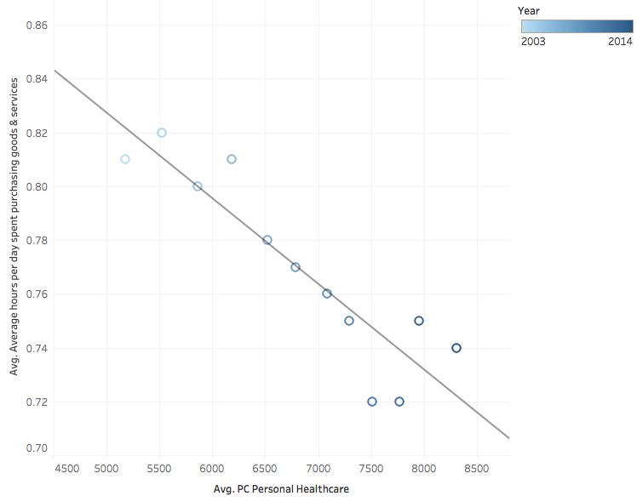
Chart 4
Examine the relationship between personal healthcare costs and average hours per day spent on purchasing goods& services.
As personal healthcare costs increase, consumer likelihood to make leisurely purchases decrease.
More healthcare costs mean people spend more time on health care activity in view of the fact that leisure time are compressed.
Figure 4

Slide 15
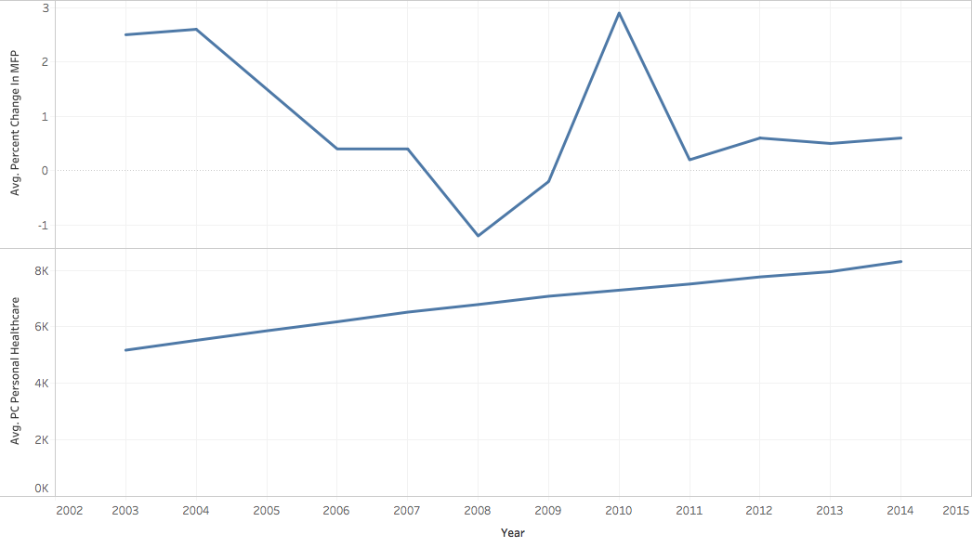
Chart 5
Examine the relationship between personal healthcare costs and percent change in MFP.
There is not a obvious correlation between them.
Change in health care costs does not affect economic cycle.
Figure 5

Slide 16
Results & discussion
There is a positive correlation between healthcare spending and labor productivity, personal income, per capita GDP, other spending.
There is a negative correlation between personal healthcare spending and Average hours per day spent purchasing goods & services.
There is a no correlation between healthcare spending and percent change in MFP, working hours.
Change in health care costs does not affect economic growth.
Different states require various personal health expenditure at a same labor productivity level.

Slide 17
Scope and limitations
Economic events such as recession may cloud our results
This research uses several proxies for productivity
Ideally we would track hours time spent being sick but it was not considered due to data unavailability
The project has no further drill down from the state level
Effects of healthcare spending on different group(such as, age groups) within a state was not studied

Slide 18
Overall Conclusions & Potential for Future Research
Unfortunately, this data does not support a large-scale link between healthcare spending and productivity
Larger, more progressive states such as California see better economic health to complement their spending
This trend is not consistent across the country, which suggests that the association is due to additional factors
Future research should be done at the state level to look into demonstrations that reduce cost
Research can be done in countries with single-payer systems to see if a link to productivity exists there

Slide 19
Managerial implications
Our results support arguments against our current healthcare system’s structure
Research has been done to show that US healthcare spending does not lead to better outcomes than other countries
This research shows that there is also little positive effect on productivity, which is another argument against the high price tag of health in the US
The effect of healthcare spending on the economy will vary by different care categories and by location(states)
A major part of healthcare spending goes to Health Insurance. The government can try to increase the reach of its public health insurance policies to benefit more and more people in need.

Slide 20
References
https://www.thebalance.com/causes-of-rising-healthcare-costs-4064878
https://www.cms.gov/Research-Statistics-Data-and-Systems/Statistics-Trends-and-Reports/NationalHealthExpendData/Downloads/Proj2012.pdf
https://www.americashealthrankings.org/learn/reports/2016-annual-report/comparison-with-other-nations
https://www.cdcfoundation.org/businesspulse/healthy-workforce-infographic

Slide 21
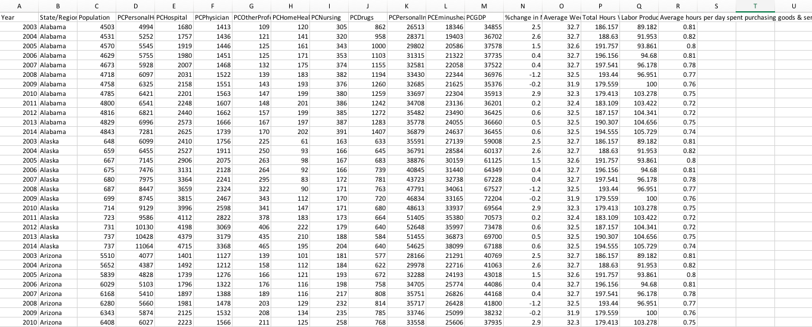
Appendix

